Slide 1
BIAS IN RISK SCORES: EXAMPLES FROM CRIME AND HEALTH DOMAINS
Keith Burghardt
February 7, 2024
DSCI 531

Slide 2
“big data analytics have the potential to eclipse longstanding civil rights protections in how personal information is used in housing, credit, employment, health, education, and the marketplace.”
White House report Big Data: Seizing Opportunities, Preserving Values, 2014

Slide 3
Disparate impact of data
The promise: AI eliminates human biases from the decision process
The reality: Algorithms are only as good as the data they were trained on
Data reflects explicit prejudices
Data reflects implicit biases persisting in society
Data reproduces existing patterns of discrimination, exclusion and inequality
“Unthinking reliance on data mining can deny historically disadvantaged and vulnerable groups full participation in society”
[Barocas, S., & Selbst, A. D. (2016). Big data's disparate impact. Calif. L. Rev., 104, 671.]

Slide 4
Is it possible to discriminate through data?
Discrimination persists in American society in employment, housing, credit, consumer markets, academia, and entertainment
While intentional discrimination and explicit prejudice are now less common, “institutional” discrimination through implicit biases and ‘business as usual’ attitudes account for disparate treatment of protected classes 🡪 encoded in patterns in data
Absence of explicit prejudice does not guarantee impartiality
AI could unintentionally, rather than maliciously, discriminate by identifying and reinforcing existing patterns of discrimination
… and inadvertently amplify inequalities by giving disadvantaged groups less favorable treatment

Slide 5
How does data come to discriminate?
Where does the unintended discrimination effects of data come from?
Five mechanisms by which data mining may systematically disadvantage protected classes
Defining the “Outcome Variable” and “Class Labels”
Training data
Feature selection
Proxies
Masking
Notes:
very point of data mining is to provide a rational basis upon which to distinguish between individuals and to reliably confer to the individual the qualities possessed by those who seem statistically similar.

Slide 6
1. Defining the “Outcome Variable” and “Class Labels”
Data mining identifies statistical relationships in data (i.e., correlations) between outcome variables and features
Statistical patterns on which to base future decisions
Learned models can classify new entities, estimate unobserved features, predict future outcomes
How are outcomes defined? –
What is “creditworthiness”? An abstraction developed for the purpose of evaluating loan default risk
what is a “good” employee? Objective measures?
what is a “healthy” patient?

Slide 7
2. Training data
Biased training data leads to discriminatory models
If prejudice played a role in generating data, algorithms will happily reproduce patterns of prejudice
if data mining draws inferences from a biased sample of the population, these inferences may systematically disadvantage those who are under- or overrepresented in the data.
Special considerations
Labels (ground truth data) are often subjective. This can skew modeling results (see example next page)
Data collected about protected classes may be systematically incorrect, or non-representative 🡪 may discriminate against protected classes.
Underrepresentation vs overrepresentation

Slide 8
Biases in hiring decisions
St. George’s Hospital (UK) developed a computer program to help sort medical school applicants based on its previous admissions decisions. Those admissions decisions systematically discriminated against racial minorities and women with similar credentials to other applicants’. By learning from prior biased decisions, St. George’s Hospital devised an automated process that propagated the same prejudices.
The computer may learn to discriminate against certain female or black applicants if trained on prior hiring decisions in which an employer has consistently rejected jobseekers with degrees from women’s or historically black colleges.

Slide 9
3. Feature selection
AI designers make choices about what attributes to collect and model
May systematically omit details to reliably resolve members of protected classes with details necessary to achieve equally accurate determinations residing at a level of granularity and coverage that the selected features fail to achieve.
Obtaining detailed information to resolve protected classes can be expensive.
See “redlining” – using a coarse proxy to make decisions , e.g., zipcode leads to less accurate decisions than fine-grained data, but is easier to collect

Slide 10
4. Proxies
Features are highly correlated with membership in the protected class
E.g., “redlining” – zipcode used instead of race to deny loan applications

Slide 11
5. Masking
Decision makers can disguise their prejudicial views by manipulating data collection, labeling, feature selection, etc.
E.g., decision makers could knowingly and purposefully bias the collection of data to ensure that the model is less favorable to members of protected classes.

Slide 12
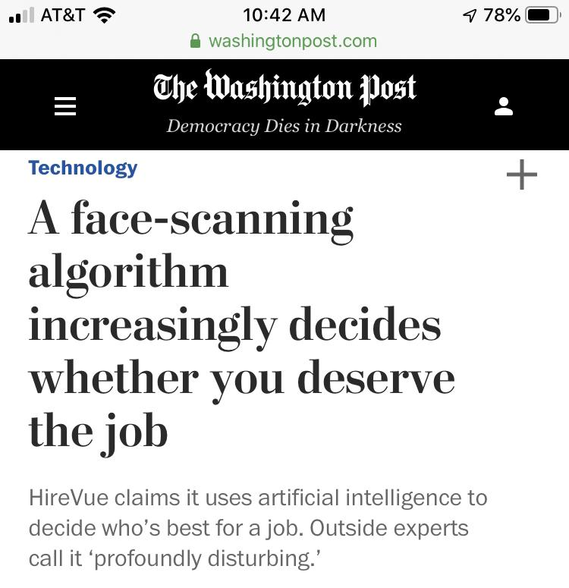
AI-based job recruiting
An artificial intelligence hiring system has become a powerful gatekeeper for some of America’s most prominent employers, reshaping how companies assess their workforce — and how prospective employees prove their worth.
Designed by the recruiting-technology firm HireVue, the system uses candidates’ computer or cellphone cameras to analyze their facial movements, word choice and speaking voice before ranking them against other applicants based on an automatically generated “employability” score.

Slide 13
Case studies
COMPAS automated risk assessment tool COMPAS tool assesses risk of future recidivism
Risk prediction in
health care

Slide 14
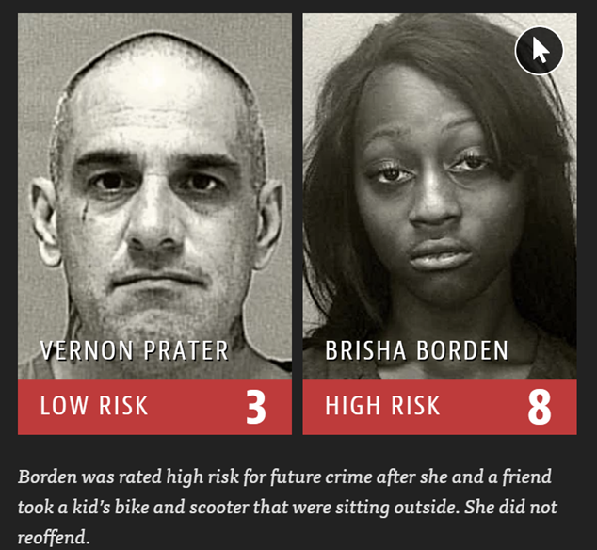
COMPAS automated risk assessment tool COMPAS tool assesses risk of future recidivism
https://www.propublica.org/article/machine-bias-risk-assessments-in-criminal-sentencing

Slide 15
The tension
Judges must balance two factors evaluating the cost of a mistake:
Let a guilty person go?
Increase in crimes committed by released defendants
Put an innocent person in jail?
social and economic costs of detaining innocent defendants.
Benefit vs cost
Benefit : expected number of crimes prevented
Cost : expected number of innocent people detained
Define utility of a decision rule, that balances benefits and costs

Slide 16

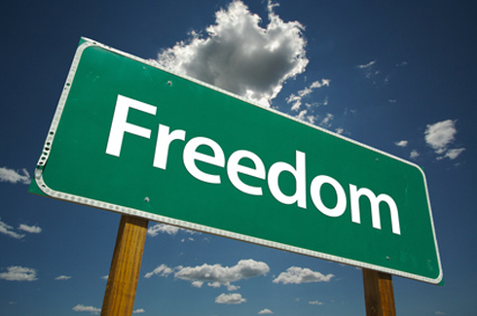
Automated risk assessment
Increasingly common in the judicial system in the US
Algorithm computes a score predicting the likelihood a defendant will commit a crime in the future (will recidivate).
High probability to commit another crime
Algorithm
(COMPAS)
Individual
Features
Risk score
Low probability to commit another crime

Slide 17
Benefits and costs of automated risk scoring
Increase efficiency and reduce prejudice
Used by judges to inform decisions about bail, sentencing, parole, conditions for release, etc.
Hoped to mitigate existing sources of bias in human judgments
In 2014 US Attorney General Eric Holder warned risk scores may be injecting bias into the courts
“Although these measures were crafted with the best of intentions, I am concerned that they inadvertently undermine our efforts to ensure individualized and equal justice. They may exacerbate unwarranted and unjust disparities that are already far too common in our criminal justice system and in our society.”

Slide 18
COMPAS
Correctional Offender Management Profiling for Alternative Sanctions
Assigns defendants risk scores between 1 and 10 that indicate how likely they are to commit a violent crime based on more than 100 factors, including age, sex and criminal history.
Defendants with scores of 7 reoffend at twice the rate as those with scores of 3.
Help judges make decisions about whether to release a defendant or hold them in jail while waiting for trial
Deployed before it was rigorously tested

Slide 19


ProPublica study
Data: 7000 people arrested in Broward County, FL (2013-2014)
COMPAS algorithm predicts whether a defendant will commit a crime within next 2 years
 | Did commit a crime | Did not commit a crime
Will commit crime | True Positives (TP) | False Positives (FP)
Will not commit a crime | False Negatives (FN) | True Negatives (TN)
Prior Offense | 1 attempted burglary
LOW RISK | 3
Subsequent Offenses | 3 drug possessions
Prior Offense | 1 resisting arrest without violence
HIGH RISK | 10
Subsequent Offenses | None

Slide 20
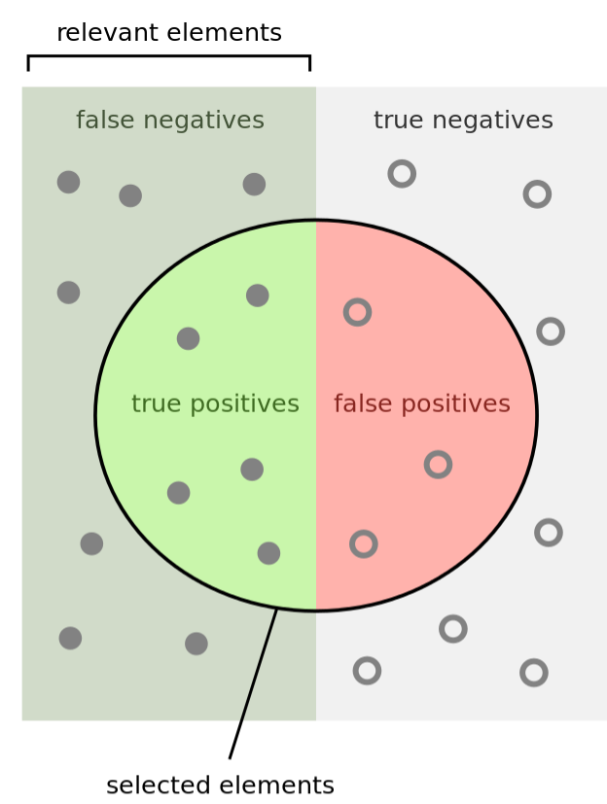
Measuring classification performance
 | Did commit a crime | Did not commit a crime
Will commit crime | True Positives (TP) | False Positives (FP)
Will not commit a crime | False Negatives (FN) | True Negatives (TN)
Accuracy = Number of correct predictions/Total predictions
Accuracy = TP + TN / (TP+TN+FP+FN)
Precision = TP / (TP + FP)
Recall = TP / (TP + FN )
Sensitivity = TP rate = TP / (TP + FN)
Specificity = TN rate = TN / (TN + FP)
False positive rate = FP / (TN + FP) = 1 - Specificity

Slide 21
COMPAS performance
Accuracy
20% accuracy for violent crimes
61% when all crimes are considered
Asymmetry of mistakes: who bears the costs?
False negatives
False positives
Racial disparity: different types of mistakes for whites and blacks

Slide 22
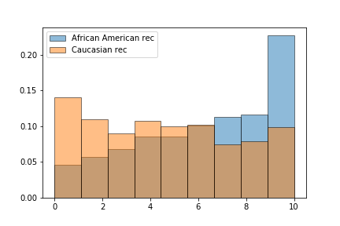
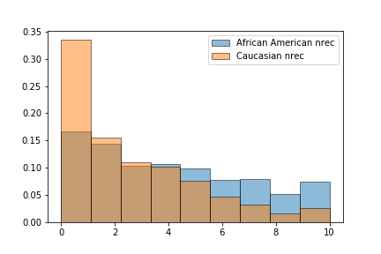
Racial disparities in COMPAS risk scores
Significant racial disparities: different types of mistakes for whites and blacks
False Positive rate high for blacks:
Algorithm falsely flagged black defendants as future criminals at 2X the rate for white defendants
False Negative rate high for whites
White defendants were mislabeled as low risk more often than black defendants.
This disparity cannot be explained by prior crimes, the type of crimes, their age and gender
Defendants who committed another crime
Defendants who did not commit another crime
Risk score
Risk score

Slide 23
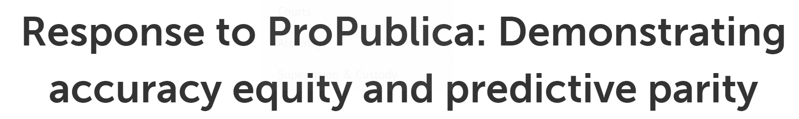
Northpointe response
ProPublica focused on classification statistics that did not take into account the different base rates of recidivism for blacks and whites.
When the correct classification statistics are used, the data does not substantiate the ProPublica claim of racial bias towards blacks.
The interpretation of the results in the samples used by ProPublica demonstrate that the General Recidivism Risk Scale (GRRS) and Violent Recidivism Risk Scale (VRRS) are equally accurate for blacks and whites.

Slide 24
Northpointe response
COMPAS has predictive parity and accuracy equity
Classifier has predictive parity if it has similar predictive values for two different groups (blacks and whites),
I.e., Probability of recidivism given a high risk score is similar for blacks and whites.
A classifier has accuracy equity if it can discriminate recidivists and nonrecidivists equally well for two different groups (blacks and whites).
Use AUC to quantify discriminative ability. The ROC curve is a plot of Sensitivity (tpr) and Specificity (tnr) for all possible cut points of a risk scale. The AUC is a summary measure of discriminative across all the thresholds. The AUC is interpreted as the probability that a randomly selected recidivist will have a higher risk score than a randomly selected non-recidivist.

Slide 25
Inherent Trade-Offs in the Fair Determination of Risk Scores
Calibration, the balance conditions for the positive and negative classes intuitively all seem to be variants of the same general goal — algorithmic predictions should have the same effectiveness regardless of group membership
But, they are incompatible with each other and can only be simultaneously satisfied in a few special cases.
Notes:
Calibration: Predictions should be well-calibrated
If algorithm gives a score 2, then the 20% of people with that score will commit a crime, regardless of race
Balance for the positive class: Average score of defendants who do commit another crime should be the same in each group
Balance for the negative class: Average score of defendants who never commit another crime should be the same for each group
i.e., both groups should have equal false positive and false negative rates
Independent of statistical parity

Slide 26
Fairness properties of risk assessments: Calibration
Goal: predictions should be well-calibrated
If the algorithm identifies a set of people as having a probability z of constituting positive instances, then approximately a z fraction of this set should indeed be positive instances
this condition should hold when applied separately in each group
Societal benefits to calibration
Score = 1
Score = 2
0.1
0.2
Score = 4
Score = 6
0.4
0.6

Slide 27
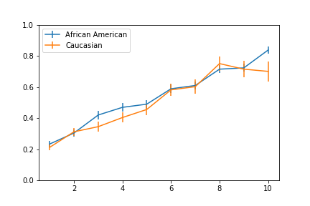
COMPAS is well calibrated
Probability of recidivism
Risk score

Slide 28
Balance of Predictions
Goal: Predictions should be well balanced
False negative for group A should be the same as the false negative rate for group B
Groups should have equal false positive rates.

Slide 29
Fairness properties of risk assessments: Balance
Predictions should be well balanced
False positive rate should be the same for all groups
Balance for the negative class: the average scores of negative members in group A (do not re-offend) should be the same as the average score of negative members in group B
i.e., risk scores shouldn’t be systematically more inaccurate for negative instances in one group than the other.
Negative instances: Defendants who do not commit another crime
Risk score
Notes:
average score assigned to people of group 1 who belong to the negative class should be the same as the average score assigned to people of group 2 who belong to the negative class.

Slide 30
Fairness properties of risk assessments: Balance
Balance for the positive class symmetrically requires that average score of defendants who do commit another crime should be the same in each group
both groups should have equal false positive and false negative rates
Positive instances: Defendants who commit another crime
Risk score
Notes:
the average score assigned to people of group 1 who belong to the positive class should be the same as the average score assigned to people of group 2 who belong to the positive class.

Slide 31
Dueling notions of fairness
Calibration requires that we treat people with the same score similarly to one other, regardless of their group (race):
In other words, conditioned on the predicted risk score, the likelihood that the individual is a member of the positive class (i.e., recidivist) is independent of the group to which the individual belongs. They should be given similar bails, and similar sentences (Northpointe’s fairness claims)
Balance requires that if two people in different groups have the same future behavior (recidivate or not), they should be treated the same way
In other words, conditioned on actual behaviors (outcomes), members of one group (never commit another crime) should not have consistently higher predicted scores than members of the other group (ProPublica’s fairness claims)

Slide 32
Fundamental limits of fairness
There are only two cases in which a risk assignment can achieve all three fairness guarantees simultaneously.
Perfect prediction
Equal base rates
In all other cases, you must sacrifice at least one fairness condition
Kleinberg, J., Mullainathan, S., & Raghavan, M. (2016). Inherent trade-offs in the fair determination of risk scores. arXiv preprint arXiv:1609.05807.

Slide 33
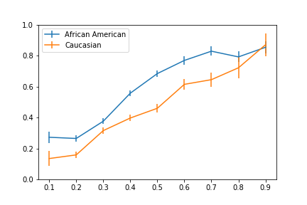
Balance vs Calibration error tradeoffs
Calibration error: area between two curves
Balance: Difference between the means for the two groups

Slide 34
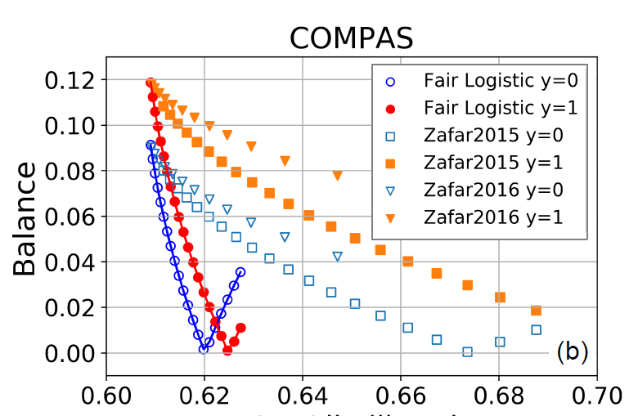
Balance vs Calibration error tradeoffs
Difference between the means for the two groups
Calibration error

Slide 35

Alternate ways to measure fairness
algorithm
Predictions
Inferred protected features
Do predictions reveal information about the protected feature?
Imagine an evil actor who reverse engineers values of the protected feature from the predictions
Measuring dependency
Pearson correlation between the predictions and the protected feature
Mutual information between the predictions and the protected feature
Accuracy of predicting the protected features from predictions

Slide 36
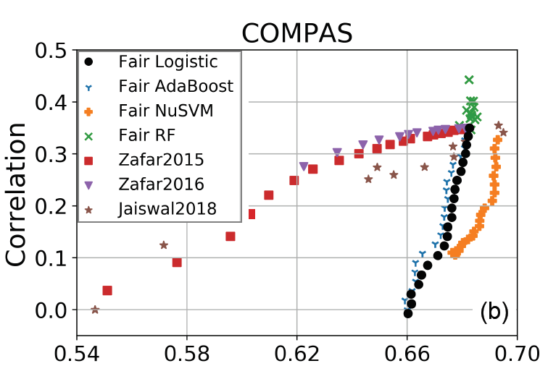
Fairness vs Accuracy tradeoffs
Accuracy

Slide 37
Debiasing heterogeneous data
debiasing data to create more fair and generalizable models
disaggregate data into homogeneous groups
disaggregate data into similarly-behaving groups
remove correlations with a given feature

Slide 38
Debiasing data
X_{p}=2
X_{p}=1
X_{p}=3
Given a protected feature or variable x_{p}
e.g., gender or race
Debias data to remove correlations* with x_{p}
Shift the distribution of data so that it does not generate Simpson’s paradox
Y
X₁
Y’
METHOD
X’₁
He, Burghardt & Lerman. (2020). A Geometric Solution to Fair Representations. In AIES.
Code: https://github.com/yuziheusc/fair_linear

Slide 39
Remove correlations with a “protected” feature x_{p} from data
y | x₁ | x₂ | … | x_{p}
features
outcome
x_{p}
2. Features x_{i} projected unto the null space are independent of the protected features
x₁
x₂
data
3. Parameter λ∈[0,1] adjusts the degree of projection
1. Create a null space orthogonal to protected feature(s) x_{p}
Notes:
Fair representation learning via linear orthogonalization: there will not be Simpson’s paradox with respect to xp.

Slide 40
Remove correlations with a “protected” feature x_{p} from data
y | x₁ | x₂ | … | x_{p}
features
outcome
Interpretable
Use with different models
Regression
Decision trees
SVM, etc
Neural networks
More fair predictions
More accurate than state-of-the-art fairness methods
data
He, Y., Burghardt, K., & Lerman, K. (2020, February). A Geometric Solution to Fair Representations. In Proceedings of the AAAI/ACM Conference on AI, Ethics, and Society https://arxiv.org/abs/1910.12854

Slide 41
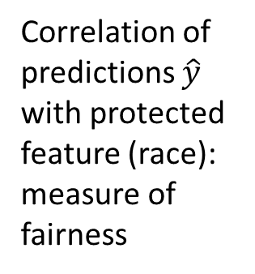
Recidivism prediction (COMPAS): Fairness vs Accuracy tradeoffs
Accuracy
METHOD
He, Burghardt & Lerman. (2020). A Geometric Solution to Fair Representations. In AIES.
Code: https://github.com/yuziheusc/fair_linear

Slide 42
Balance vs Calibration error tradeoffs
Difference between the means for the two groups
METHOD
Calibration error
He, Burghardt & Lerman. (2020). A Geometric Solution to Fair Representations. In AIES.
Code: https://github.com/yuziheusc/fair_linear

Slide 43
Mechanism of bias in COMPAS
Where does the COMPAS data come from?
Level of Service Inventory – Revised (LSI)
A lengthy questionnaire for the prisoner to fill out, with questions like
“How many prior arrests have you had?”
“What part did alcohol and drugs play?”
“The first time you were involved with the police?”
The questions themselves treat minority classes differentially and contribute to the feedback loop amplifying bias (masking)
Also, differences in policing norms across neighborhoods lead to different arrest rates for different groups

Slide 44
Lessons learned: How algorithms can discriminate
Transparency
How is the data collected? Is the bias built into data collection?
Choices of what data to collect, what variables to model reflect ideology and blind spots
Are participants aware of being modeled? Do they know how their data is used?
Does the model rely on proxies? Are they valid?
Asymmetry
Who is harmed by the mistakes? Is the damage born by all groups equally?
Is the harm of False Positives comparable to the harms of False Negatives?
Feedback
Does the model learn from mistakes? Is it updated when ground truth changes?
Does it create a feedback loop that exacerbates the damage?

Slide 45
RISK PREDICTION IN HEALTH CARE OBERMEYER, Z., POWERS, B., VOGELI, C., & MULLAINATHAN, S. (2019). DISSECTING RACIAL BIAS IN AN ALGORITHM USED TO MANAGE THE HEALTH OF POPULATIONS. SCIENCE, 366(6464), 447-453.

Slide 46
Main findings
Health systems use algorithms to identify and help patients with complex health needs,
Algorithms are racially biased: Conditioned on risk score, Black patients are considerably sicker than White patients
Removing the disparity would increase the percentage of Black patients receiving care from 17.7 to 46.5%.
The bias arises because health care costs are used as a proxy of health. However, unequal access to health care means that less money is spent on caring for Black patients than White patients.
The choice of convenient, seemingly effective proxies for ground truth can be a source of algorithmic bias.

Slide 47
The problem
Health systems rely on algorithms to identify patients who will benefit from costly health interventions
Identifying patients who will benefit from interventions is a challenging causal inference problem. Instead, health systems use a key assumption: Patients with the greatest care needs will benefit the most from the program.
This is a prediction problem: use past data to predict future health care needs.
This study: Access to data, specifically inputs, outputs, and eventual outcomes, allows to quantify racial disparities in algorithms and isolate the mechanisms by which they arise.

Slide 48
The study
Patients
6,079 Black; 43,539 White
Predict R_{i,t} risk score for patient i in year t,
Predicted on the basis of claims data X_{i,(t−1)} from the prior year.
Patients above the 97th percentile are automatically identified for enrollment in the program.
Assess performance and fairness
Compare the risk score R_{i,t} to patient’s health outcomes H_{i,t}
Which fairness metrics?: Focus on calibration bias [comparing Blacks B and Whites W]: E[Y|R;W]=E[Y|R; B] indicates the absence of bias
Assess how well the algorithmic risk score is calibrated across race for health outcomes Hi,t
How well the algorithm is calibrated for costs

Slide 49
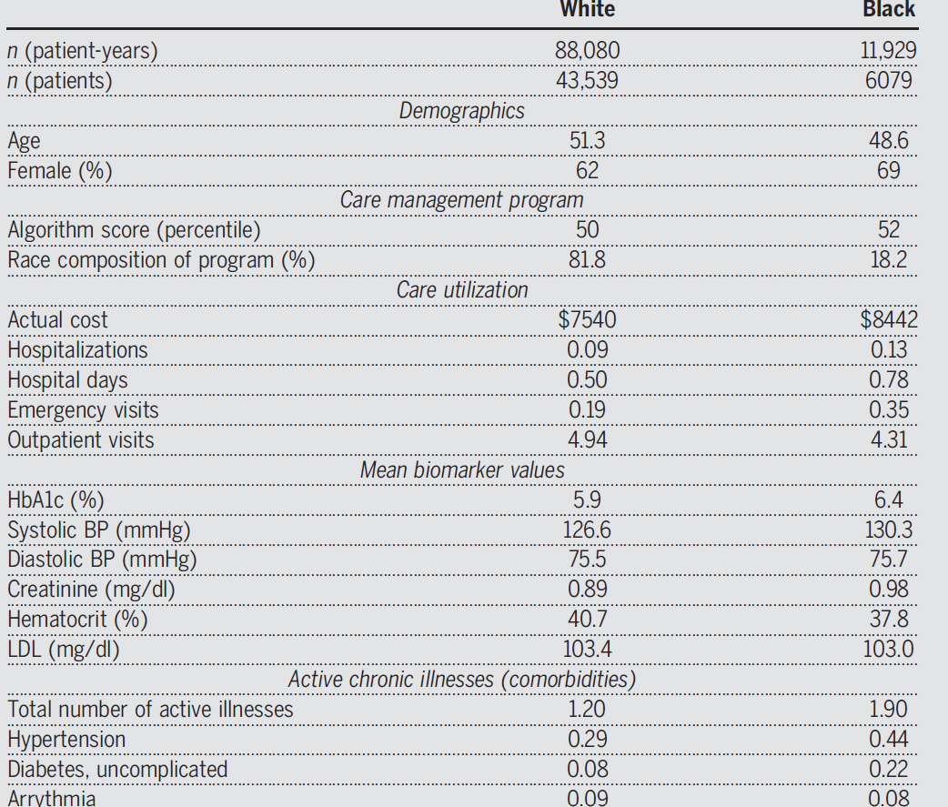
Racial differences in health

Slide 50
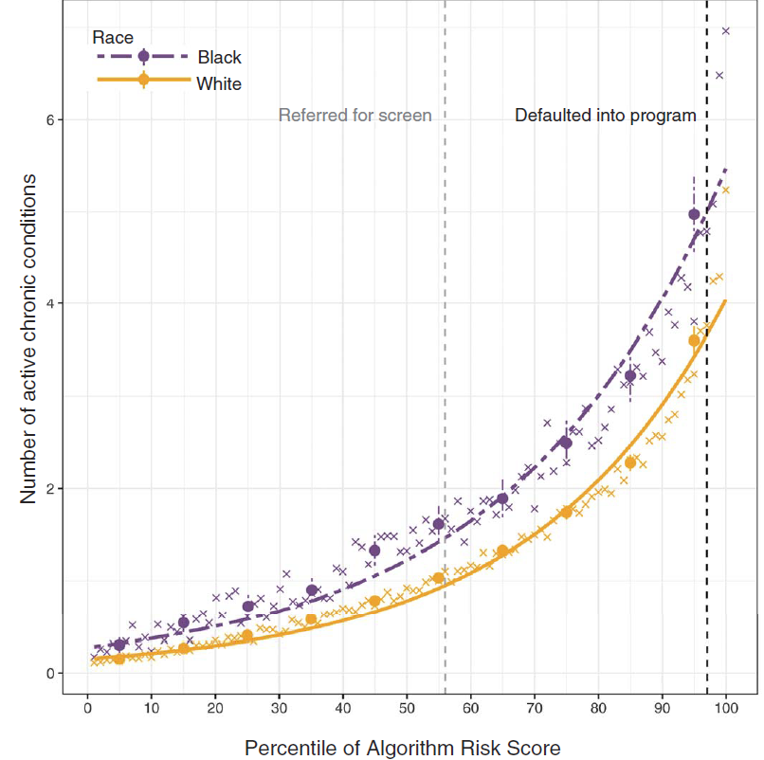
Health disparities conditioned on risk scores
Calculate the overall measure of health (number of active chronic conditions) by race, conditional on algorithmic risk score.
At the same level of risk, Blacks have significantly more comorbidities than Whites.
E.g., at 97% risk score, Blacks have 26.3% more chronic illnesses than Whites (4.8 versus 3.8 distinct conditions; P < 0.001)

Slide 51
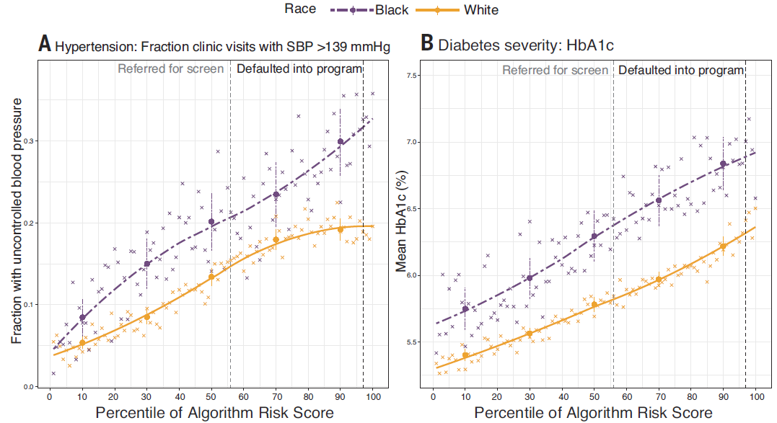
Racial disparities persist across all markers of health
Blacks have more-severe hypertension and diabetes: up to 30% differences in mortality
Notes:
Disparities persist across all of important markers of health needs—severity of diabetes, high blood pressure, renal failure, cholesterol, and anemia—we find that Blacks are substantially less healthy than Whites at any level of algorithm predictions

Slide 52
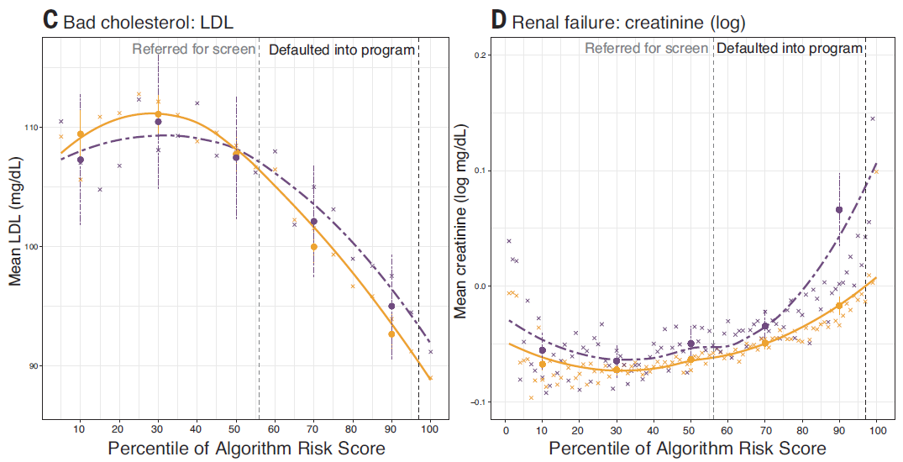
Racial disparities persist across all markers of health

Slide 53
Mechanism of bias
Study has all the data to investigate mechanisms giving rise to algorithmic health disparities
Algorithm takes as input
set of raw insurance claims X_{i,t−1} (features) over the previous year,
demographics (e.g., age, sex), but not race
insurance type, diagnosis and procedure codes,
medications, detailed costs.
The algorithm uses these data to predict outcome/label Y_{i,t} (health) in year t.
Design decision: use total medical costs C_{t} in year t as a proxy of outcome.
Health and costs are highly correlated: sicker patients receive more care, on average
Thus, instead of predicting health needs, it predicts health costs

Slide 54
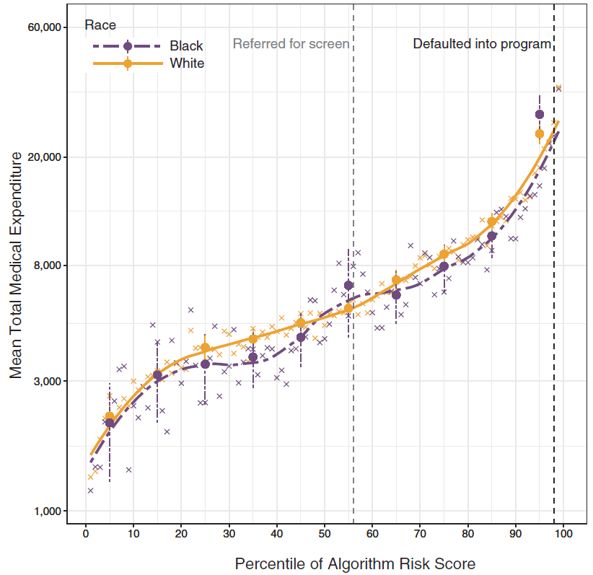
Algorithm is well calibrated across races
Algorithm is well calibrated: at every level of predicted risk, Blacks and Whites have (roughly) the same costs the following year.
Conditioned on risk, predictions do not favor Blacks or Whites
Eg, at the median risk score, Black patients had costs of $5147 vs $4995 for Whites;
in the top 5% of algorithm-predicted risk, costs were $35,541 for Blacks versus $34,059 for Whites.
Realized costs C (mean medical expenditures)
Predicted costs R (% algorithm risk score)

Slide 55
Why is this surprising?
Findings:
There are substantial disparities in health conditional on risk,
But little disparity in costs.
Source of disparity: the gap between needing health care and receiving health care is correlated with race.

Slide 56
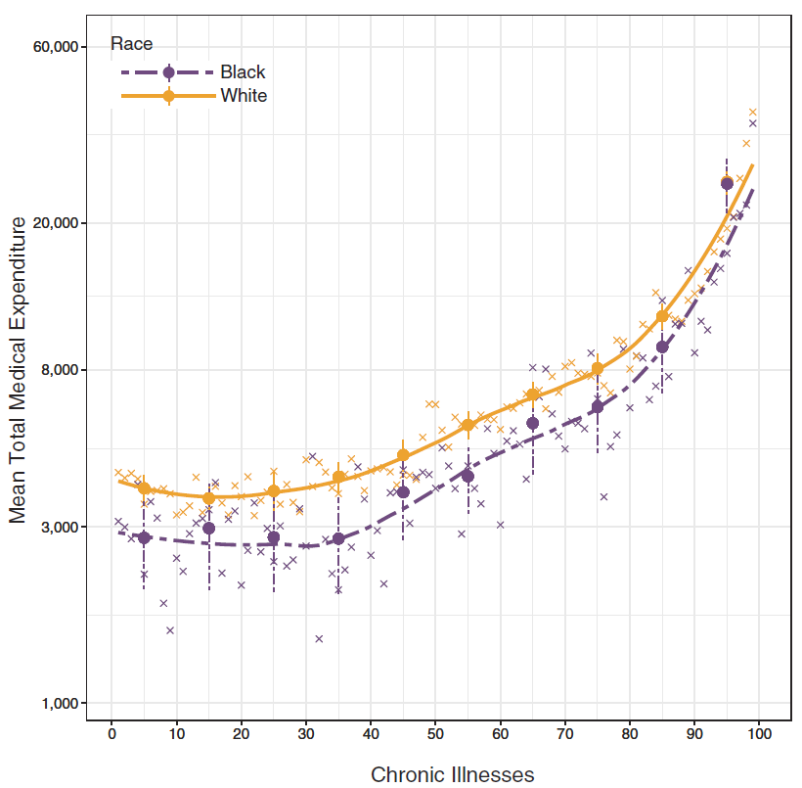
Racial gap in health expenditures
At a given level of health (measured by number of chronic illnesses), Blacks have lower costs than Whites—on average, $1801 less per year, holding constant the number of chronic illnesses.
Origin of bias: Black patients generate lesser medical expenses, conditional on health, even when we account for specific comorbidities.
As a result, accurate prediction of costs necessarily means being racially biased on health.

Slide 57
Origins of racial disparities in health costs
Socioeconomic factors
Poor patients (even when insured) face barriers to accessing health care. Poverty can lead to disparities in use of health care: geography and differential access to transportation, childcare and job demands.
To the extent that race and socioeconomic status are correlated, these factors will differentially affect Blacks.
Prejudice (communication, trust or bias)
Discrimination in doctor–patient relationship, etc. Physicians’ perceptions of Black patients, in terms of intelligence, affiliation, or pain tolerance
Black patients have reduced trust in the health care system due to adverse experiences.
The collective effect is to lower health spending for Black patients, conditional on need

Slide 58
Choosing a label on which to train the algorithm
On the one hand, the choice to predict future costs is reasonable: The program’s goal is to reduce costs, and it stands to reason that patients with the greatest future costs could have the greatest benefit from the program.
On the other hand, future cost is by no means the only reasonable choice. For example, care management programs do not reduce costs, but prevent catastrophic health care utilization. Thus, avoidable future costs, i.e., emergency visits and hospitalizations, could be a useful label to predict
Alternatively, rather than predicting costs at all, we could simply predict a measure of health; e.g., the number of active chronic health conditions.
Health care costs, though easily quantifiable and readily available in insurance claims, are also the result of a complex aggregation process with a number of distortions due to structural inequality, incentives, and inefficiency.

Slide 59
Alternate labels/outcomes
How does label choice affect predictive performance and racial bias?
Algorithms trained to predict the following outcomes:
total cost in year t (this tailors cost predictions to our own dataset rather than the national training set),
avoidable cost in year t (due to emergency visits and hospitalizations),
health in year t (measured by the number of chronic conditions that flare up in that year).
3-fold cross validation of all models
trained on a random ⅔ training set and show all results only from the ⅓ holdout set.
Exclude race from the feature set

Slide 60
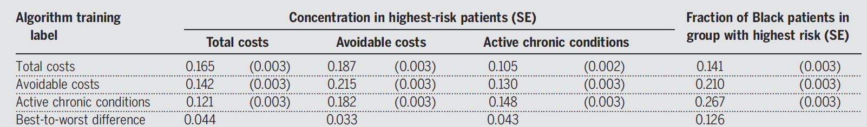
Performance of predictors trained on alternate labels
Performance: All algorithms perform well for predicting the outcome on which they were trained and other outcomes: The concentration of realized outcomes in those at or above the 97th percentile is notably similar for all algorithms across all outcomes.
Bias: the racial composition of highest-risk group varies across algorithms: fraction of Black patients at or above risk levels ranges from 14.1% to 26.7%.
Although there are many reasonable choices of label—all predictions are highly correlated, and any could be justified as a measure of patients’ likely benefit from the program—they have markedly different implications in terms of bias, with nearly 2x variation in composition of Black patients in the highest-risk groups.
Notes:
Performance of predictors trained on alternative labels. For each new algorithm, we show the label on which it was trained (rows) and the
concentration of a given outcome of interest (columns) at or above the 97th percentile of predicted risk. We also show the fraction of Black patients
in each group.

Slide 61
Label choice is a big source of algorithmic bias
Labels meant to capture ineffable factors (“health”, “good worker”) are often measured with errors that reflect structural inequalities.
Health: Using mortality or readmission rates to measure hospital performance penalizes those serving poor or non-White populations
Credit-scoring: algorithms that predict outcomes related to income incorporate disparities in salary.
Policing: algorithms predict crime, also reflect increased scrutiny to marginalized communities
Hiring: algorithms predict employment decisions or worker ratings are affected by race and gender biases.
Retail: algorithms, which set pricing for goods at the national level, penalize poorer households, which are subjected to higher prices as a result.

Slide 62
Reducing bias is possible
Labels are the key determinant of both predictive performance and predictive bias;
Careful choice can allow us to enjoy the benefits of algorithmic predictions while minimizing their harms.
Producing new labels, however, requires deep understanding of the domain, the ability to identify and extract relevant data elements, and the capacity to iterate and experiment.

Slide 63
Polygenic Risk Scores

Slide 64
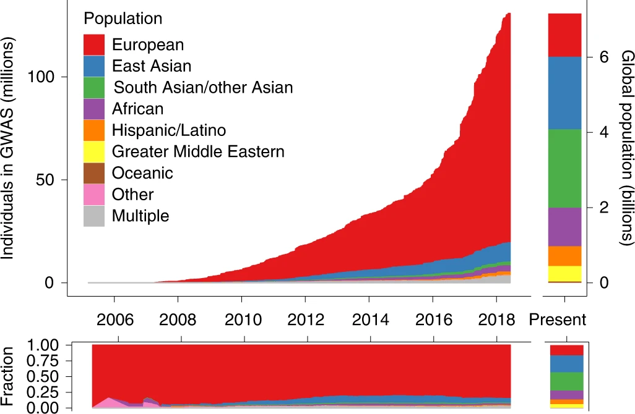

Slide 65
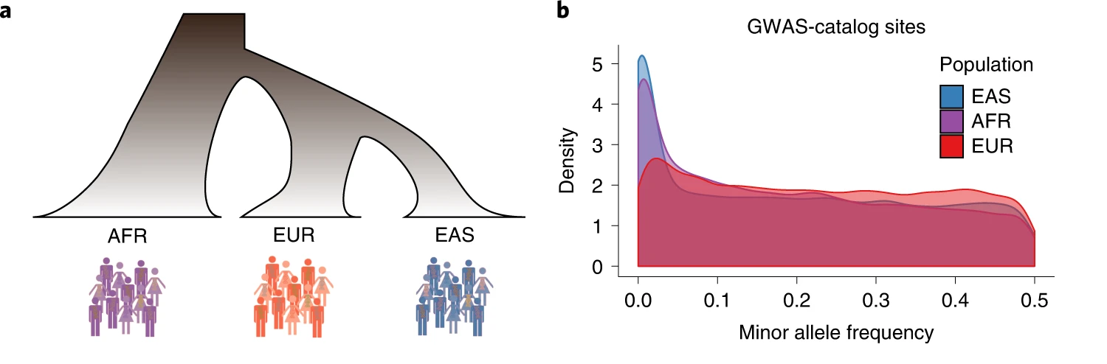

Slide 66
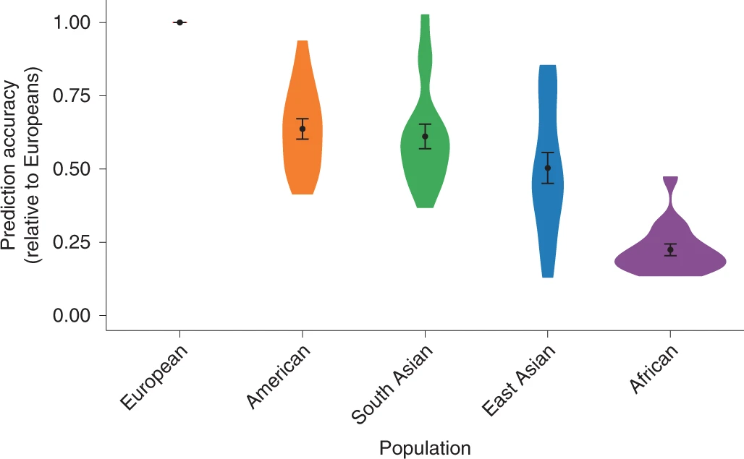

Slide 67
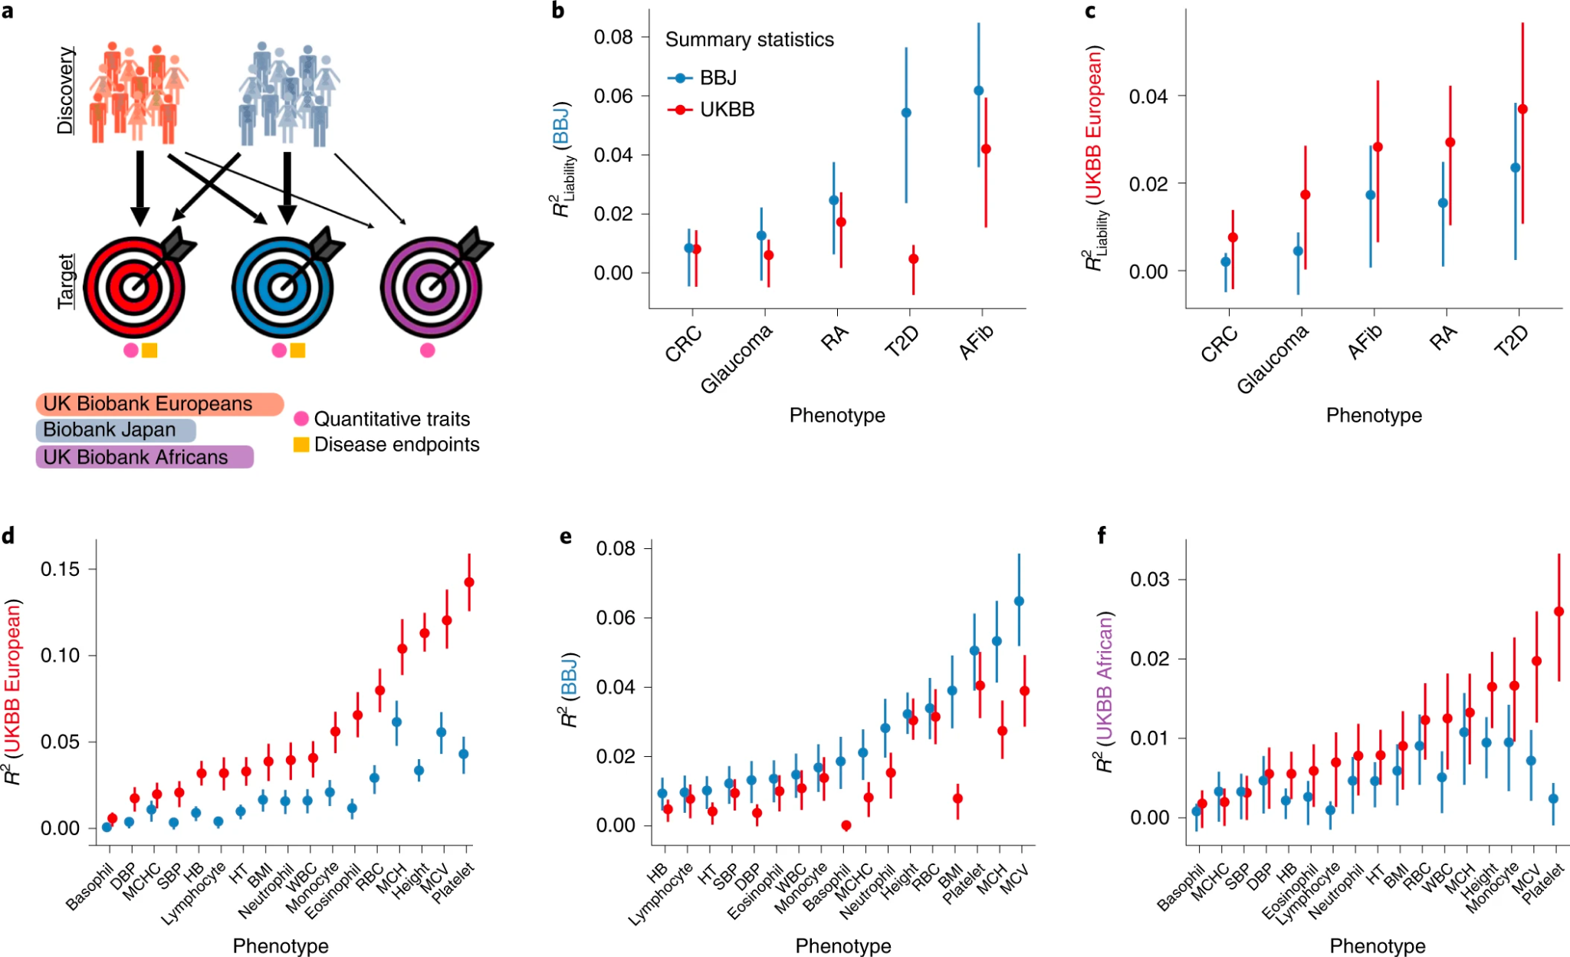

Slide 69
Data Risks - Do you have control of your data?
23andMe data is used to track criminals
Sometimes helpful but it could be seen as data being used outside of your control

Slide 70
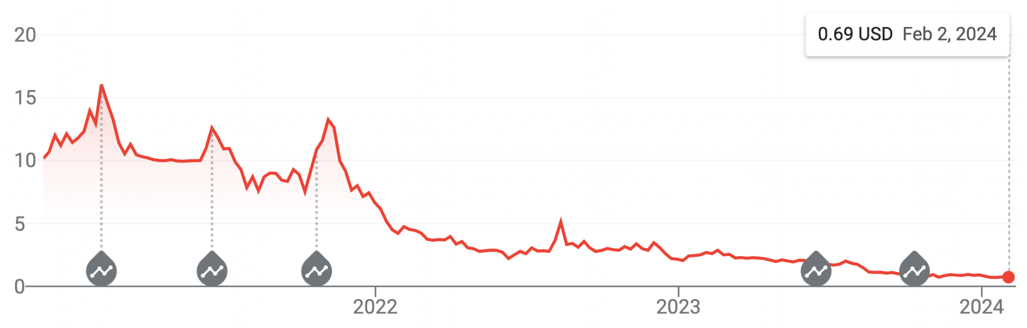
Impacts on 23andMe
Lower utility, data uses, and especially needing only 1 test in a lifetime meant 23andMe lacked profitability
But where will their data go? Will it be purged or sold to a 3rd party?

Slide 71
Polygenic Risk Scores
https://genomemedicine.biomedcentral.com/articles/10.1186/s13073-018-0610-x
https://www.biorxiv.org/content/10.1101/2021.01.12.426453v1.full
https://www.nature.com/articles/s41588-019-0379-x

Slide 72
Lessons learned: Why models fail
Transparency
Is the model transparent or opaque? Or even invisible?
Are participants aware of being modeled?
Do people know model’s conclusions?
Are the mistakes the model makes symmetric?
Does the model learn from mistakes?
Is it updated dynamically when ground truth changes?
Does it create a feedback loop that exacerbates the damage
Does the model use proxies?
Models using actual data about the behavior, rather then proxies, are more likely to be valid

Slide 73
How algorithms can go wrong
Blackbox algorithms are unfair
They cannot explain their decisions, and you cannot appeal their decisions
Algorithms are unfair when their mistakes are asymmetric
Damage of False Positives vs damage done by False Negatives
Algorithms are unfair when they do not learn from their mistakes
Algorithms may be unfair when they rely on proxies
of the behavior or outcome they are measuring
Algorithms are unfair when they create pernicious feedback loops
Algorithms may be unfair by design
Designer decides what data to collect, what variables to model
Choices reflect designer’s ideology and blind spots

